Slide 1
Naoise DALY Final year project Bayesian inference in hierarchical models

Slide 2
Outline
Hierarchical models
Bayesian inference
Monte Carlo Markov Chains
Estimating convergence

Slide 3
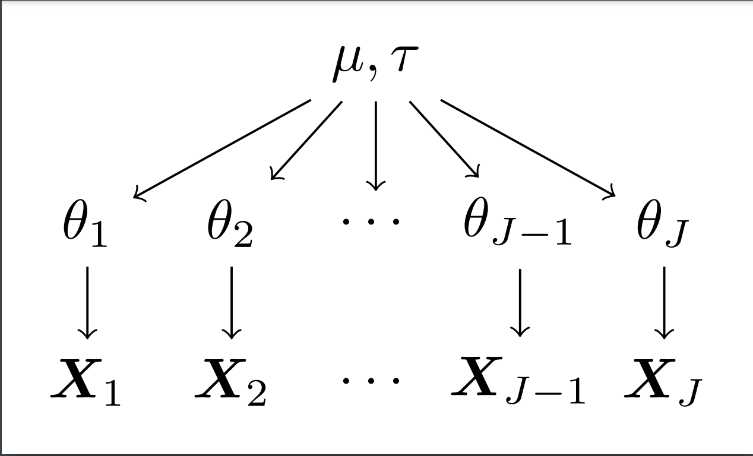
Hierarchical Models
Observations on J different groups
Assumes each group may have a distribution with different underlying parameters but that each of those parameters comes from a common ”population” distribution.
E.g. Normal Normal

Slide 4
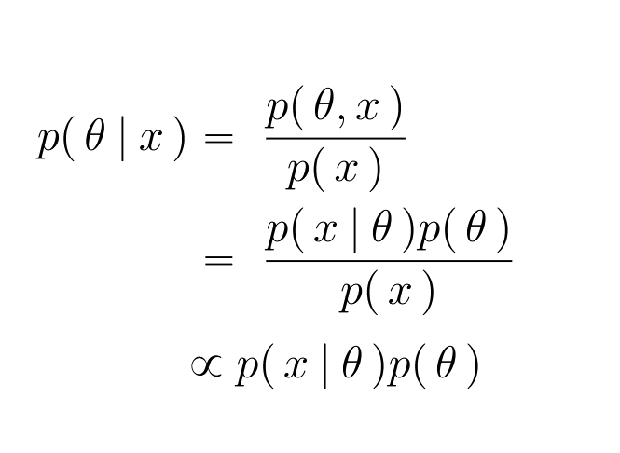
Bayesian inference
Can be applied even in the case of hierarchical models – simplifies due to conditional independence
Choice of prior matters
Posterior usually difficult to normalise in practice

Slide 5
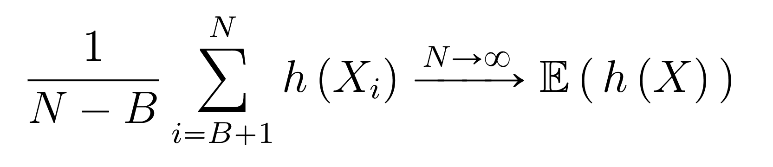
Monte Carlo
Used when a function of random variables from some distribution is desired but is not feasible analytically

Slide 6
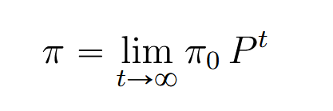
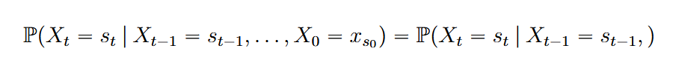
Markov chains
A sequence of random variables that have the Markov property
Evolve according to a “transition kernel” – can be encoded as steps in an algorithm
Can be used to get samples from a “target” distribution via Metropolis Hastings algorithm

Slide 7
Demo Markov chain reaching stationarity
Q -How to long to run the chain in practice?

Slide 8
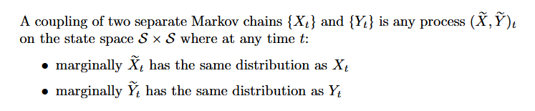
Coupling of chains

Slide 9
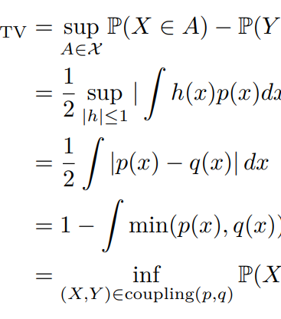
Total variation distance
Distance metric for probability distributions
Cannot be used directly here as the pdf

Slide 10
Demo coupled chains Meeting

Slide 11
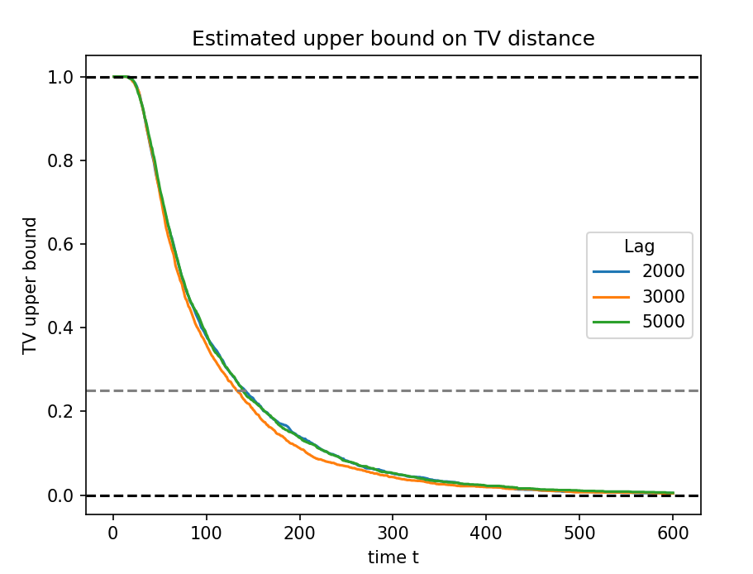
Why
The meeting times of chains coupled with a lag with the same target distribution can be used to estimate distance to stationarity
This quantifies how long to run a chain for in practical settings before being confident in the samples.

Slide 12
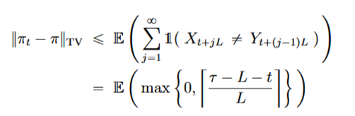
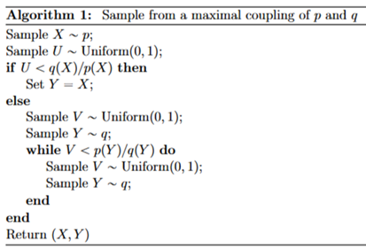
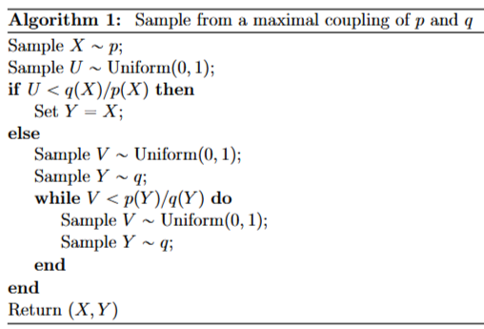
how
Monte Carlo

Slide 13
Thank you

